Slide 1


INSTITUTE : UIE
DEPARTMENT : CSE
Bachelor of Engineering (Computer Science & Engineering)
WEB AND MOBILE SECURITY (Professional Elective-I)
(20CST/IT-333)
TOPIC OF PRESENTATION:
Mobile Security-Security of GSM Networks, Security of UMTS Networks
DISCOVER . LEARN . EMPOWER

Slide 2
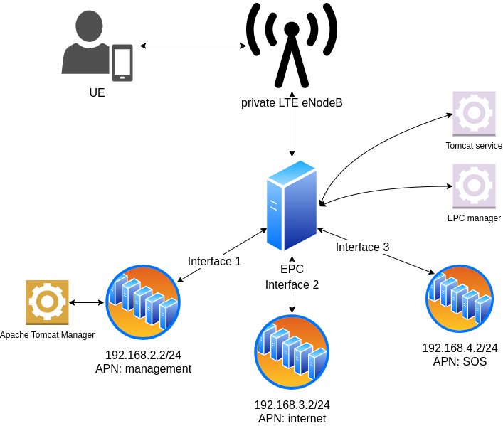
Lecture Objectives
In this lecture, we will discuss:
Mobile Security-Security of GSM Networks, Security of UMTS and LTE Networks

Slide 3
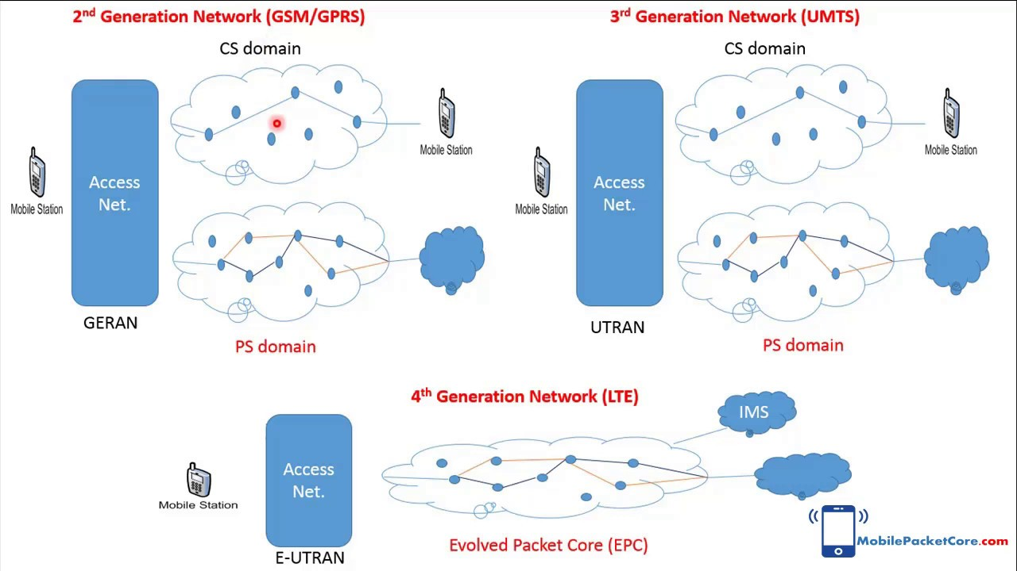

Slide 4
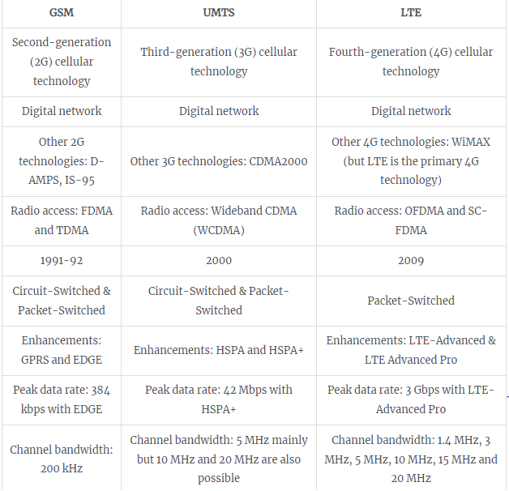
Difference Between GSM, UMTS And LTE?
https://commsbrief.com/difference-between-gsm-umts-lte/

Slide 5
GSM
The GSM network is divided in 4 sections :
• Mobile Stations The subscriber will use a mobile station to make and receive calls via the GSM network. The MS is composed of two distinct functional entities, the subscriber identity module (SIM), which is a removable smart card, and the mobile equipment.
• Base Station Subsystem (BSS) The MS communicates with the base transceiver station (BTS) via the radio interference. A BTS performs all the transmission and reception functions relating to the GSM.
• Network Management Every BSS is connected to a Mobile services switching centre (MSC). The MSC is concerned with the routing of calls to and from the mobile users. The Home Location Center (HLR) is used to store information that is specific to each subscriber. Every GSM subscriber will have a record in the HLR.

Slide 6
Security features
The subscriber is uniquely identified by the International Mobile Subscriber Identity (IMSI). This information, along with the individual subscriber authentication key (Ki), constitutes sensitive identification credentials analogous to the Electronic Serial Number (ESN) in analog systems such as AMPS and TACS. Security in GSM consists of the following aspects:
• Authentication
• Signal and Data confidentiality
• Identity confidentiality

Slide 7
Algorithms
Encryption algorithms GSM algorithms were developed in secret, official descriptions were not published to the public. Most of the information available come from leaked documents and cryptanalysis projects. GSM specifications define 3 algorithms:
A3 the authentication algorithm.
A8 the key generation algorithm.
A5 the encryption algorithm.
https://web.itu.edu.tr/~korkusuza/Security%20in%20the%20GSM%20Network.pdf?kategori=php

Slide 8
UMTS network
UMTS is designed to interoperate with GSM networks. To protect GSM networks against man-in-middle attacks, 3GPP is considering to add a structure RAND authentication challenge.
Five security groups exist in UMTS networks as shown in the figure. • Network Access Security • Network domain security • User domain security • Application domain security • visibility, configurability of security
https://www.rfwireless-world.com/Tutorials/3G-security.html

Slide 9
UMTS Security
The security functions of UMTS are based on what was implemented in GSM. Some of the security functions have been added and some existing have been improved. Encryption algorithm is stronger and included in base station (NODE-B) to radio network controller (RNC) interface , the application of authentication algorithms is stricter and subscriber confidentially is tighter. The main security elements that are from GSM:
Authentication of subscribers
Subscriber identity confidentially
Subscriber Identity Module (SIM) to be removable from terminal hardware
Radio interface encryption
Additional UMTS security features:
Security against using false base stations with mutual authentication
Encryption extended from air interface only to include Node-B to RNC connection
Security data in the network will be protected in data storages and while transmitting ciphering keys and authentication data in the system.
Mechanism for upgrading security features.
https://www.umtsworld.com/technology/security.htm

Slide 10
LTE security
LTE authentication is the process of determining whether a user is an authorized subscriber to the network that he/she is trying to access, while NAS security and AS security are features required to securely deliver user data that travels through LTE radio links at NAS and AS levels.
Voice over LTE (VoLTE) is a packet-based telephony service seamlessly integrated into the Long Term Evolution (LTE) standard. By now all major telecommunication operators use VoLTE. To secure the phone calls, VoLTE encrypts the voice data between the phone and the network with a stream cipher.
Integrity
“0000” EIA0 Null Integrity Protection algorithm
“0001” 128-EIA1 SNOW 3G
“0010” 128-EIA2 AES
Ciphering
“0000” EEA0 Null ciphering algorithm
“0001” 128-EEA1 SNOW 3G based algorithm
“0010” 128-EEA2 AES based algorithm
https://www.3glteinfo.com/lte-security-architecture/
https://csrc.nist.gov/CSRC/media/Presentations/LTE-Security-How-Good-is-it/images-media/day2_research_200-250.pdf

Slide 11
References:
Books:
Hacking Exposed Mobile: Security Secrets & Solutions 1st Edition, Kindle Edition, by Neil Bergman, Mike Stanfield, Jason Rouse, and Joel Scambray
Hacking Exposed Web Applications, 3rd edition, Joel Scambray, Vincent Liu, Caleb Sima, Released October 2010, Publisher(s): McGraw-Hill
Reference Links:
https://www.cse.iitb.ac.in/~vishalprajapati08/Study/CS649/GSM%20and%20UMTS%20Security%20Report.pdf
https://www.tutorialspoint.com/umts/umts_authentication.htm
https://www.geeksforgeeks.org/difference-between-umts-and-gsm/
https://www.umtsworld.com/technology/security.htm
Relevant Videos:
https://www.youtube.com/watch?v=WqBR6jd0IbU
https://www.youtube.com/watch?v=LLq1WnY1GjQ

Slide 12

THANK YOU

